Slide 1
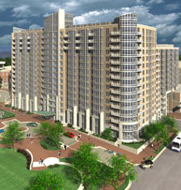
Wisconsin Place Residential
Chevy Chase, Maryland
Kurt Krasavage Structural Option

Slide 2
Presentation Outline
- Building Overview
Thesis Objective
Architectural Breadth Study
Structural Depth Study
Construction Breadth Study
Summary and Conclusions
Acknowledgements
Questions

Slide 3
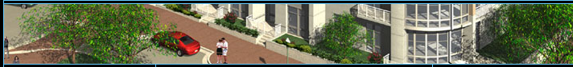
15 - Story, U-shaped residential tower consisting of 432 units within a world-class urban development.
Building Overview
Building Overview
Thesis Objective
Architectural Breadth
Structural Depth
Construction Breadth
Conclusions
Acknowledgements
Questions
Features
Location
Project Team
Structural System
2 - levels of underground parking
1,000 S.F. pool located on the 13th floor.
Size: 479,000 S.F.
Cost: $94 Million
Dates of Construction:
May 2006 – February 2009

Slide 4
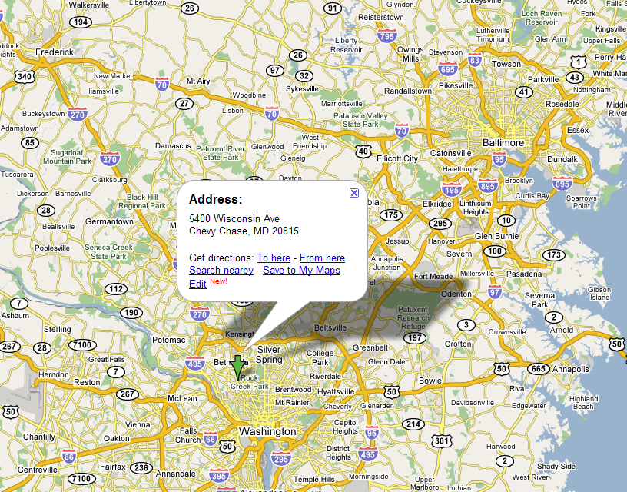
Building Overview
Building Overview
Thesis Objective
Architectural Breadth
Structural Depth
Construction Breadth
Conclusions
Acknowledgements
Questions
Features
Location
Project Team
Structural System

Slide 5
Owner/Developer:
Archstone-Smith
Architect:
SK&I Architectural Design Group
Landscape Architect:
Carol R. Johnson Associates
Structural Engineer:
Smislova, Kehnemur, & Associates
MEP Engineer:
GHT Limited
Civil Engineer:
Loiederman Soltesz Associates
Interior Designers:
Handel Architects
General Contractor:
Turner Construction
Building Overview
Building Overview
Thesis Objective
Architectural Breadth
Structural Depth
Construction Breadth
Conclusions
Acknowledgements
Questions
Owner
Features
Location
Project Team
Structural System
SK&I Architectural Design Group
Turner Construction
GHT Limited
Smislova, Kehnemur, & Associates
Subcontractors
Loiederman Soltesz Associates

Slide 6
Building Overview
Building Overview
Thesis Objective
Architectural Breadth
Structural Depth
Construction Breadth
Conclusions
Acknowledgements
Questions
Foundations
Typical Floors
The foundations consist of spread and combined footings. These footings are typically
12’ X 12’ by 24” thick.
Flat plate 7 ½” thick unbounded post‐tension slabs, with two‐way bottom reinforcement of #4@24” continuous bars each way.
Normal weight concrete at 5000 psi.
The post‐tension cables consist of uniform tendons being pulled in the S‐N direction and the banded tendons are in the pulled in the W‐E direction of the building
Features
Location
Project Team
Structural System
Columns
Reinforced concrete columns that are typically 16”x28” and 16”x32”. The typical reinforcement is 8 #7 or 8 #8 bars, but varies throughout typical levels.

Slide 7
Building Overview
Building Overview
Thesis Objective
Architectural Breadth
Structural Depth
Construction Breadth
Conclusions
Acknowledgements
Questions
Lateral System
Concrete shear walls around the two elevator cores.
Three other shear walls spread out on the west wing side of the building.
Typical thickness of each shear wall is approximately 12”
Features
Location
Project Team
Structural System

Slide 8
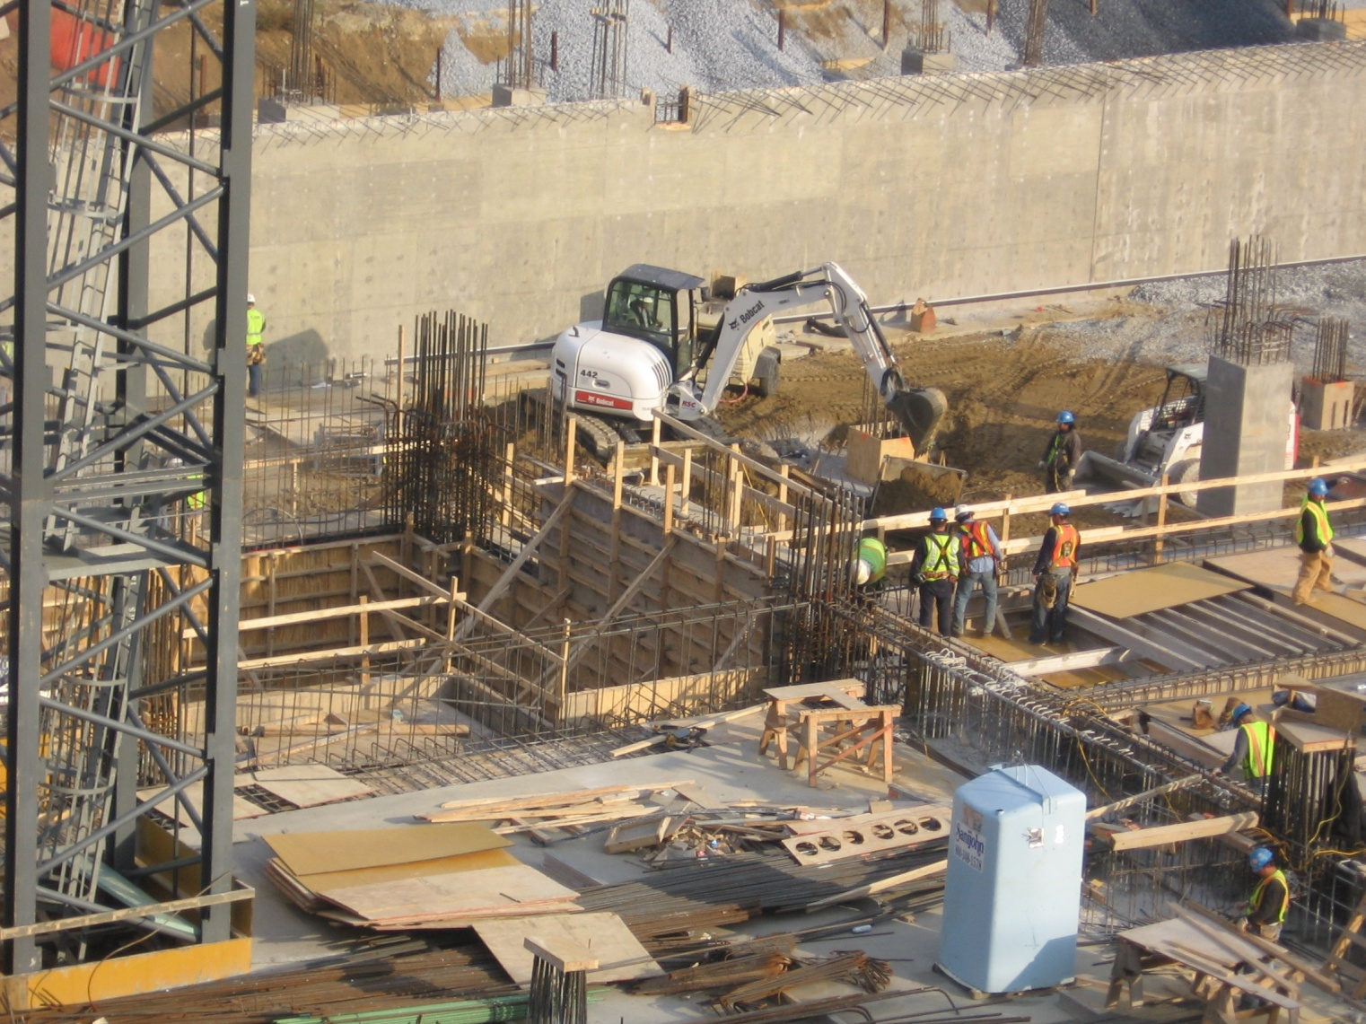
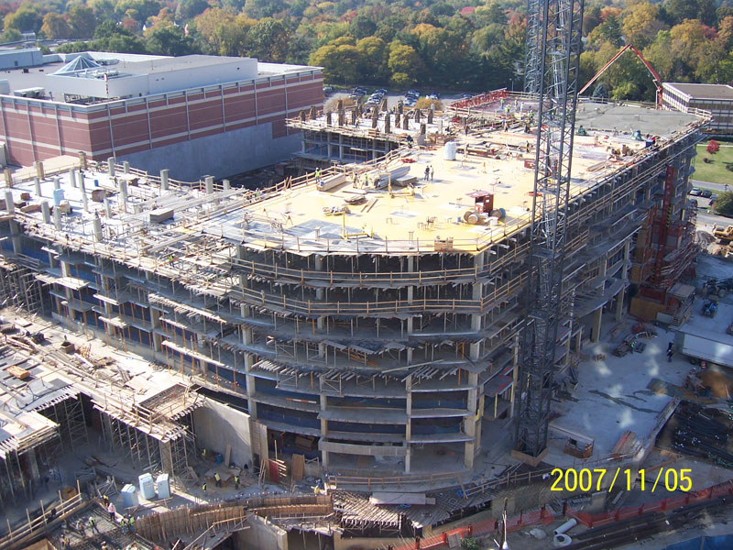
Architectural Goals
Structural Goals
Thesis Objective
Building Overview
Thesis Objective
Architectural Breadth
Structural Depth
Construction Breadth
Conclusions
Acknowledgements
Questions
Construction Goals
Integrate a new column layout that coincides with existing building architecture
Improve overall quality of floor plans
Design apartments that meet square footage requirements while maintaining style, shape, and overall quality
Design floor system and supporting elements to resist gravity loading for the proposed building
Design a lateral system that will resist wind and seismic forces due to strength and servicability for the proposed structure
Architectural Breadth
Structural Depth
Construction Breadth
Accelerate the speed of construction and save the owner as much money as possible

Slide 9
Thesis Assumptions
Thesis Assumptions
Architectural Breadth
Building Overview
Thesis Objective
Architectural Breadth
Structural Depth
Construction Breadth
Conclusions
Acknowledgements
Questions
Assume that the two levels of underground parking will be capable of being integrating within the proposed column layout
Proposed Layout
Building Dimensions
Square Footage
Location of Lateral Resisting Elements
Functionalism
Inclusive Floor Plan
Enlarged View of Typical Apartments
The existing pool located on the 13th floor will be capable of being relocated to the connecting community center

Slide 10
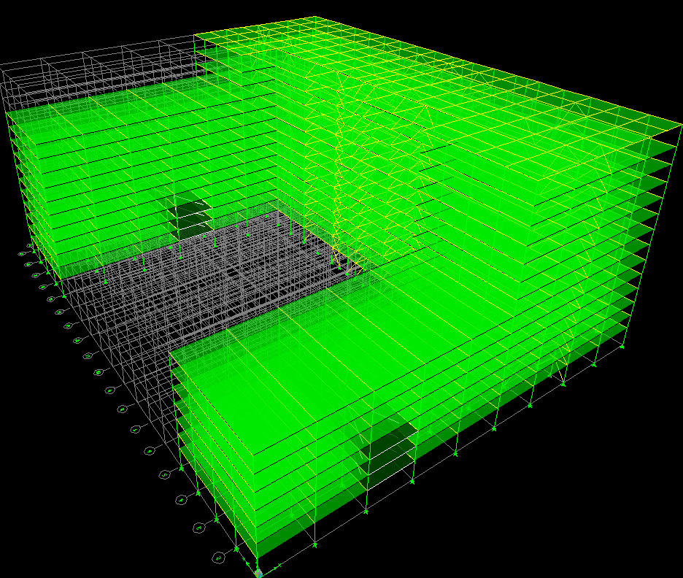
Existing Building
Proposed Layout
Architectural Breadth
Building Overview
Thesis Objective
Architectural Breadth
Structural Depth
Construction Breadth
Conclusions
Acknowledgements
Questions
Proposed Layout
Building Dimensions
Square Footage
Location of Lateral Resisting Elements
Functionalism
Inclusive Floor Plan
Enlarged View of Typical Apartments

Slide 11
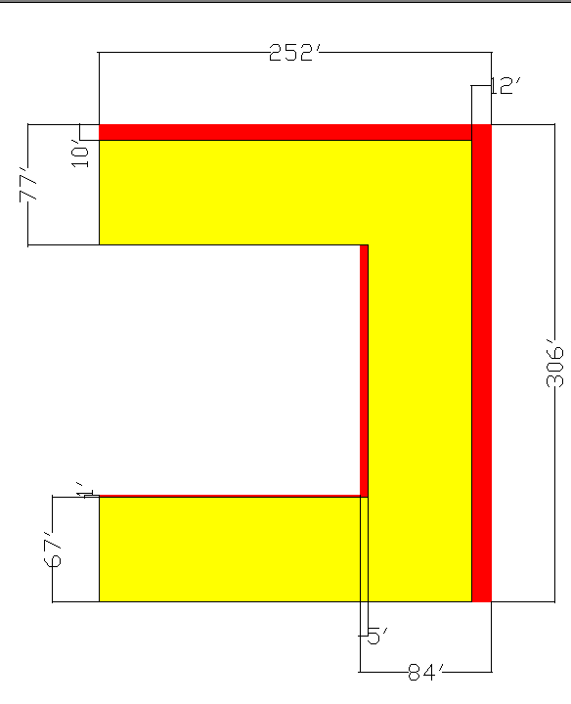
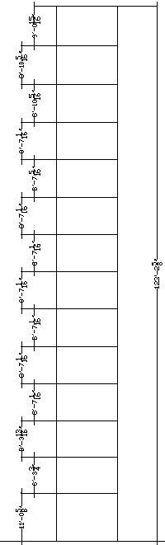
Building Dimensions
Floor-to-Floor Heights
Architectural Breadth
Building Overview
Thesis Objective
Architectural Breadth
Structural Depth
Construction Breadth
Conclusions
Acknowledgements
Questions
Proposed Layout
Building Dimensions
Square Footage
Location of Lateral Resisting Elements
Functionalism
Inclusive Floor Plan
Enlarged View of Typical Apartments

Slide 12
Building Dimensions
Architectural Breadth
Building Overview
Thesis Objective
Architectural Breadth
Structural Depth
Construction Breadth
Conclusions
Acknowledgements
Questions
Proposed Layout
Building Dimensions
Square Footage
Location of Lateral Resisting Elements
Functionalism
Inclusive Floor Plan
Enlarged View of Typical Apartments

Slide 13
Building Dimensions
Existing Building
Proposed Building
Architectural Breadth
Building Overview
Thesis Objective
Architectural Breadth
Structural Depth
Construction Breadth
Conclusions
Acknowledgements
Questions
Proposed Layout
Building Dimensions
Square Footage
Location of Lateral Resisting Elements
Functionalism
Inclusive Floor Plan
Enlarged View of Typical Apartments

Slide 14
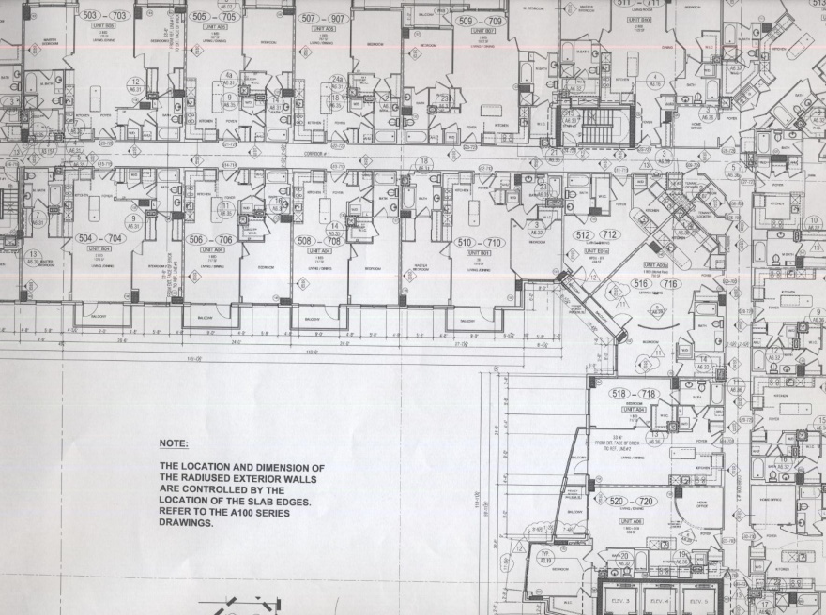
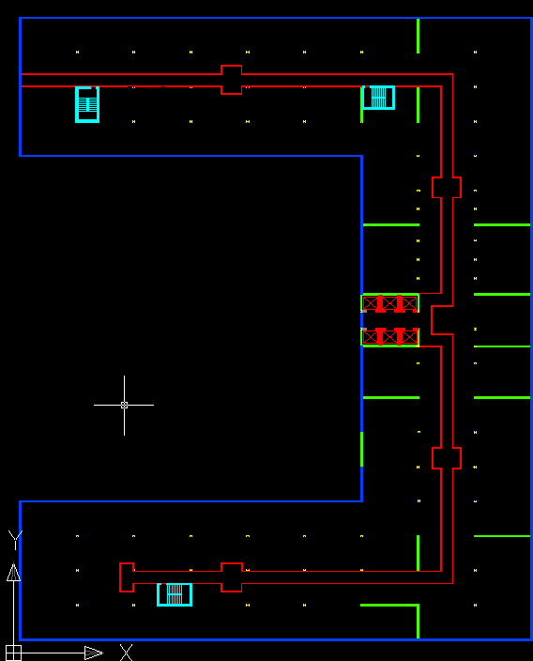
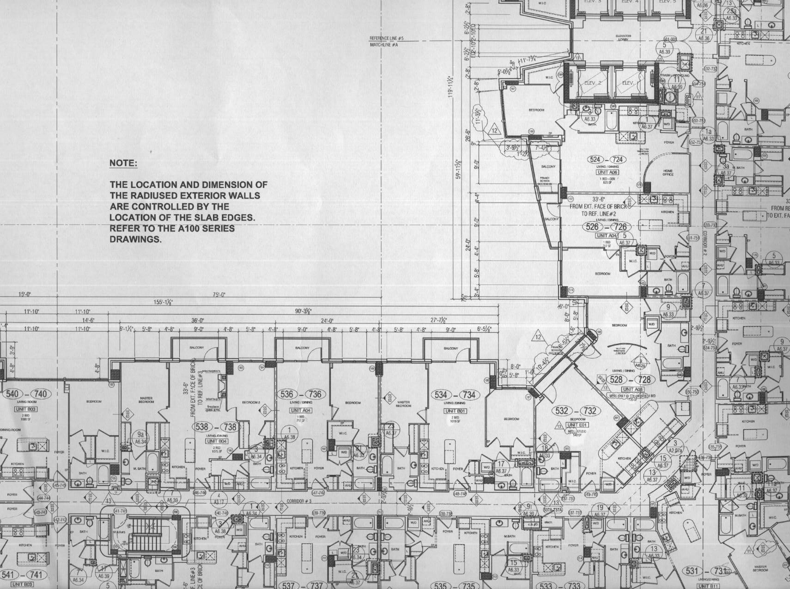
Building Dimensions
Existing Building
Proposed Building
Architectural Breadth
Building Overview
Thesis Objective
Architectural Breadth
Structural Depth
Construction Breadth
Conclusions
Acknowledgements
Questions
Proposed Layout
Building Dimensions
Square Footage
Location of Lateral Resisting Elements
Functionalism
Inclusive Floor Plan
Enlarged View of Typical Apartments

Slide 15
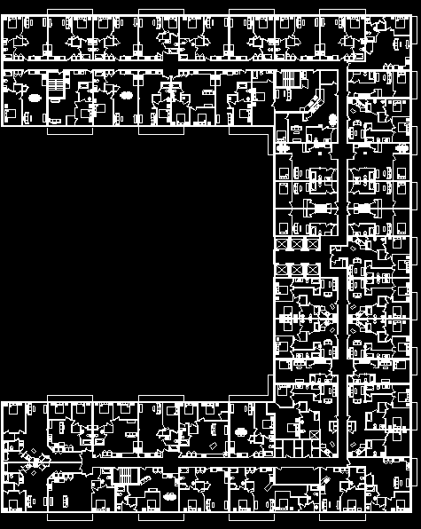
Architectural Breadth
Building Overview
Thesis Objective
Architectural Breadth
Structural Depth
Construction Breadth
Conclusions
Acknowledgements
Questions
Proposed Layout
Building Dimensions
Square Footage
Location of Lateral Resisting Elements
Functionalism
Inclusive Floor Plan
Enlarged View of Typical Apartments

Slide 16
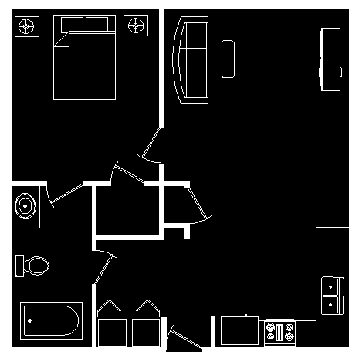
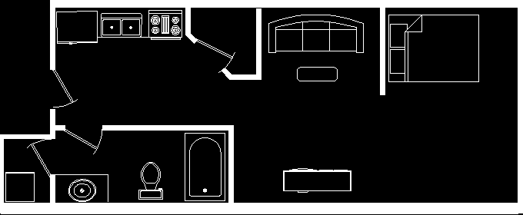
1- Bedroom
Architectural Breadth
Building Overview
Thesis Objective
Architectural Breadth
Structural Depth
Construction Breadth
Conclusions
Acknowledgements
Questions
Studio
Proposed Layout
Building Dimensions
Square Footage
Location of Lateral Resisting Elements
Functionalism
Inclusive Floor Plan
Enlarged View of Typical Apartments
500 S.F
712 S.F

Slide 17
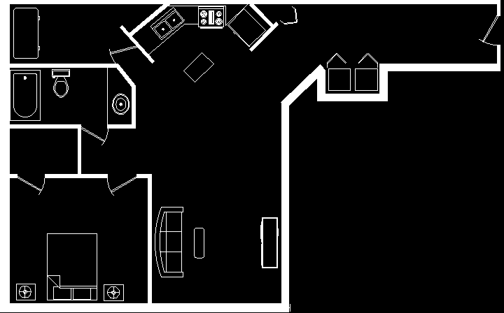
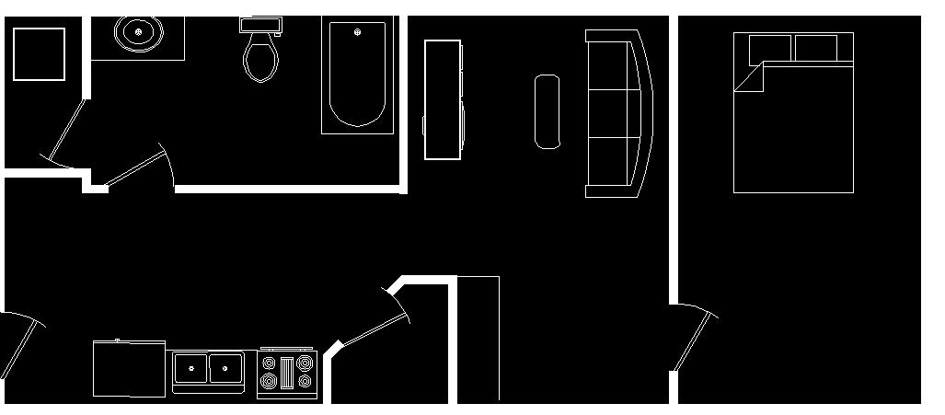
1- Bedroom
Architectural Breadth
Building Overview
Thesis Objective
Architectural Breadth
Structural Depth
Construction Breadth
Conclusions
Acknowledgements
Questions
1- Bedroom
Proposed Layout
Building Dimensions
Square Footage
Location of Lateral Resisting Elements
Functionalism
Inclusive Floor Plan
Enlarged View of Typical Apartments
600 S.F
1000 S.F

Slide 18
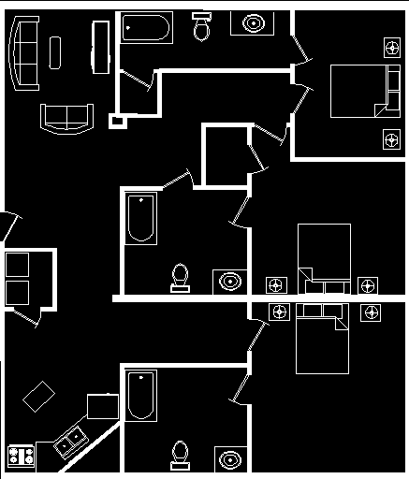
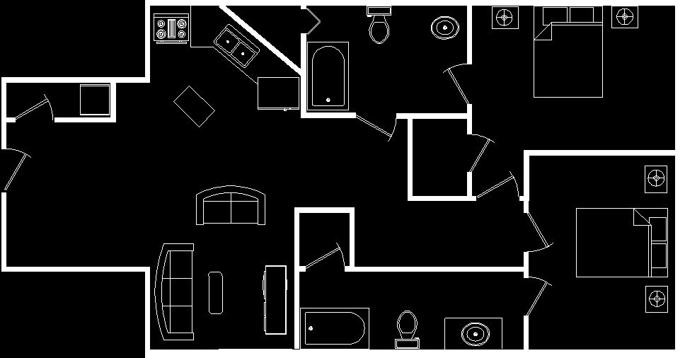
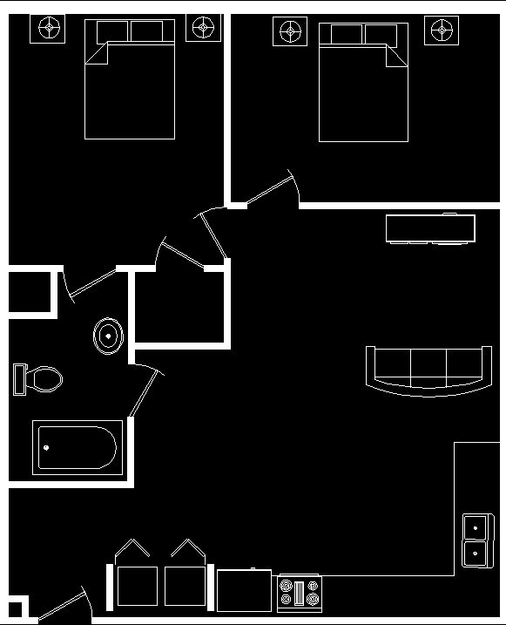
1000 S.F
3- Bedroom
2- Bedroom
2- Bedroom
Architectural Breadth
Building Overview
Thesis Objective
Architectural Breadth
Structural Depth
Construction Breadth
Conclusions
Acknowledgements
Questions
Proposed Layout
Building Dimensions
Square Footage
Location of Lateral Resisting Elements
Functionalism
Inclusive Floor Plan
Enlarged View of Typical Apartments
1400 S.F
1062 S.F
712 S.F.

Slide 19
Post-Tensioned
Structural Depth
Building Overview
Thesis Objective
Architectural Breadth
Structural Depth
Construction Breadth
Conclusions
Acknowledgements
Questions
Composite Deck w/ Non-Composite Steel Framing
Alternate Systems
Overview of Girder-Slab
Floor Framing
Wind Distribution
Seismic Distribution
Braced Frames
Drift
Two-way Flat Plate
Girder-Slab

Slide 20
Girder-Slab
Advantages
Structural Depth
Building Overview
Thesis Objective
Architectural Breadth
Structural Depth
Construction Breadth
Conclusions
Acknowledgements
Questions
Low floor-to-floor heights
Super-fast structure and building completion
Reduced building structure weight
Limited weather impact
Limited on-site labor
Reduced on-site overhead costs
Alternate Systems
Overview of Girder-Slab
Floor Framing
Wind Distribution
Seismic Distribution
Braced Frames
Drift

Slide 21
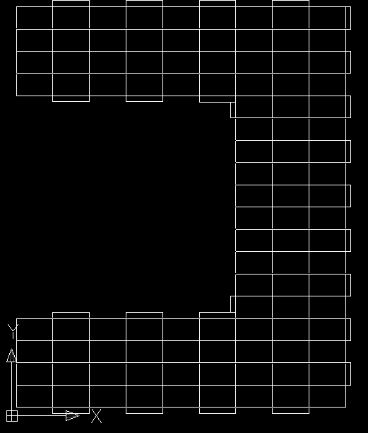
Precast Hollow Core Planks
Structural Depth
Building Overview
Thesis Objective
Architectural Breadth
Structural Depth
Construction Breadth
Conclusions
Acknowledgements
Questions
Alternate Systems
Overview of Girder-Slab
Floor Framing
Wind Distribution
Seismic Distribution
Braced Frames
Drift
Supporting D-Beams

Slide 22
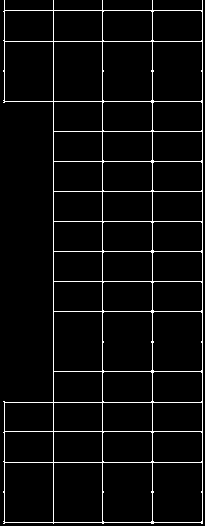
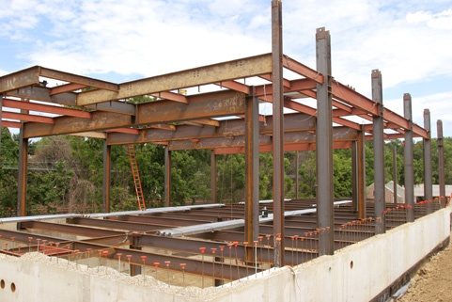
Structural Depth
Building Overview
Thesis Objective
Architectural Breadth
Structural Depth
Construction Breadth
Conclusions
Acknowledgements
Questions
Main Roof Framing
Alternate Systems
Overview of Girder-Slab
Floor Framing
Wind Distribution
Seismic Distribution
Braced Frames
Drift
Girders
W24X68
Beams
W16X31
Columns
W12X40 through W12X120

Slide 23
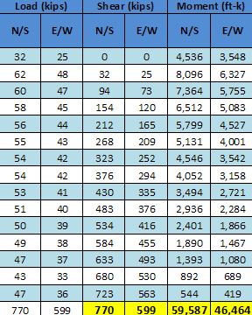
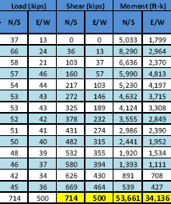
Existing Building Wind Distribution
Proposed Building Wind Distribution
Structural Depth
Building Overview
Thesis Objective
Architectural Breadth
Structural Depth
Construction Breadth
Conclusions
Acknowledgements
Questions
Alternate Systems
Overview of Girder-Slab
Floor Framing
Wind Distribution
Seismic Distribution
Braced Frames
Drift

Slide 24
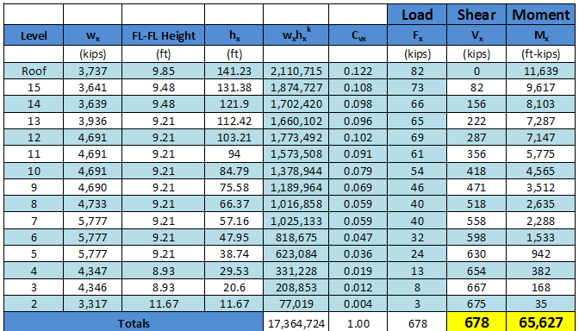
Existing Building Seismic Distribution
Proposed Building Seismic Distribution
Structural Depth
Building Overview
Thesis Objective
Architectural Breadth
Structural Depth
Construction Breadth
Conclusions
Acknowledgements
Questions
Alternate Systems
Overview of Girder-Slab
Floor Framing
Wind Distribution
Seismic Distribution
Braced Frames
Drift

Slide 25
Building Dimensions
Braced Frames
East – West Direction
Structural Depth
Building Overview
Thesis Objective
Architectural Breadth
Structural Depth
Construction Breadth
Conclusions
Acknowledgements
Questions
Alternate Systems
Overview of Girder-Slab
Floor Framing
Wind Distribution
Seismic Distribution
Braced Frames
Drift

Slide 26
Building Dimensions
Braced Frames
North - South Direction
Structural Depth
Building Overview
Thesis Objective
Architectural Breadth
Structural Depth
Construction Breadth
Conclusions
Acknowledgements
Questions
Alternate Systems
Overview of Girder-Slab
Floor Framing
Wind Distribution
Seismic Distribution
Braced Frames
Drift

Slide 27
Building Dimensions
Drift due to Wind
North - South Direction
Drift due to Wind
East – West Direction
Structural Depth
Building Overview
Thesis Objective
Architectural Breadth
Structural Depth
Construction Breadth
Conclusions
Acknowledgements
Questions
Alternate Systems
Overview of Girder-Slab
Floor Framing
Wind Distribution
Seismic Distribution
Braced Frames
Drift

Slide 28
Drift due to Seismic
East – West Direction
Structural Depth
Building Overview
Thesis Objective
Architectural Breadth
Structural Depth
Construction Breadth
Conclusions
Acknowledgements
Questions
Drift due to Seismic
North - South Direction
Alternate Systems
Overview of Girder-Slab
Floor Framing
Wind Distribution
Seismic Distribution
Braced Frames
Drift

Slide 29
Existing Building Cost
Proposed Building Cost
Construction Breadth
Building Overview
Thesis Objective
Architectural Breadth
Structural Depth
Construction Breadth
Conclusions
Acknowledgements
Questions
Cost Analysis
Scheduling Impacts
Estimated Revenue
Proposed building is approximately 25% more expensive to construct

Slide 30
Existing Building Schedule
Proposed Building Schedule
Construction Breadth
Building Overview
Thesis Objective
Architectural Breadth
Structural Depth
Construction Breadth
Conclusions
Acknowledgements
Questions
Cost Analysis
Scheduling Impacts
Estimated Revenue
Proposed building will decrease duration of construction of the structure by 4 - months

Slide 31
Existing Building
Rent Generated per Month
Proposed Building
Rent Generated per Month
Construction Breadth
Building Overview
Thesis Objective
Architectural Breadth
Structural Depth
Construction Breadth
Conclusions
Acknowledgements
Questions
Cost Analysis
Scheduling Impacts
Estimated Revenue
Proposed building will decrease duration of construction of the structure by 4 - months

Slide 32
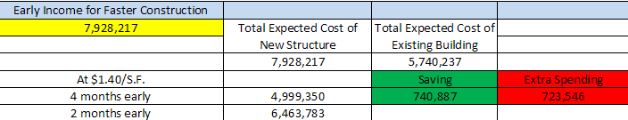
Revenue generated by Rent
Proposed Building
Rent Generated per Month
Construction Breadth
Building Overview
Thesis Objective
Architectural Breadth
Structural Depth
Construction Breadth
Conclusions
Acknowledgements
Questions
Cost Analysis
Scheduling Impacts
Estimated Revenue

Slide 33
Architectural Goals
17’ X 28’ bays with braced frames
Gained an additional 45,000 S.F. which resulted in 70 more apartments
Corridors were shortened and opened up to prevent the feeling of walking through a tunnel
An additional elevator was integrated with proposed system
Architecture not only complied with square footages, but provided more variety, i.e. non-typical apartments, option of a 3-bedroom and also used the concept of mirroring apartments to save money on construction costs.
Summary
Conclusion and Summary
Building Overview
Thesis Objective
Architectural Breadth
Structural Depth
Construction Breadth
Conclusions
Acknowledgements
Questions
Integrate a new column layout that coincides with existing building architecture
Improve overall quality of floor plans
Design apartments that meet square footage requirements while maintaining style, shape, and overall quality
Architectural Breadth
Structural Depth
Construction Breadth
Overall Conclusion

Slide 34
Structural Goals
Foundations will not significantly change due to the loading on columns and weight of the building
Rolled W12 shapes were spliced and redesigned every 4- floors
8” x 4’0” Hollow core planks with a 2” topping spanned 28’, while DB9 X46 beams spanned 17’. Typical grout; 6ksi
Lateral system consisted of 20 specially concentric braced frames that resisted strength and met servicability requirements for drift due to seismic and wind loads
Summary
Conclusion and Summary
Building Overview
Thesis Objective
Architectural Breadth
Structural Depth
Construction Breadth
Conclusions
Acknowledgements
Questions
Design floor system and supporting elements to resist gravity loading for the proposed building
Design a lateral system that will resist wind and seismic forces due to strength and servicability for the proposed structure
Architectural Breadth
Structural Depth
Construction Breadth
Overall Conclusion

Slide 35
Construction Goals
Proposed building system was found to be approximately 25% more expensive to construct upfront
Proposed system was estimated to cost $7,876,923.00
Highly probable that the proposed building will be completed at least 4- months earlier than existing building
The addition apartments will generate enough revenue to offset the cost of construction and additionally save the owner $750,000,000
Additional revenue for the 70 additional apartments will generate income throughout the life of the building
Summary
Conclusion and Summary
Building Overview
Thesis Objective
Architectural Breadth
Structural Depth
Construction Breadth
Conclusions
Acknowledgements
Questions
Accelerate the speed of construction and save the owner as much money as possible
Architectural Breadth
Structural Depth
Construction Breadth
Overall Conclusion

Slide 36
Summary
Overall Conclusion and Recommendation
Thesis Assumptions
Changing the current structural system of a two-way flat plate post-tensioned slab with shear walls to a precast girder-slab floor utilizing braced frames would save the owner approximately $750,000 and improve the overall floor plan. This number does not include the future revenue generated by the 70 additional apartment throughout the life of the building
Conclusion and Summary
Building Overview
Thesis Objective
Architectural Breadth
Structural Depth
Construction Breadth
Conclusions
Acknowledgements
Questions
Assume that the two levels of underground parking will be capable of being integrated within the proposed column layout
The existing floor located on the 13th floor will be capable of being relocated to the connecting community center
Architectural Breadth
Structural Depth
Construction Breadth
Overall Conclusion

Slide 37

Acknowledgements
Questions
Acknowledgements
Building Overview
Thesis Objective
Architectural Breadth
Structural Depth
Construction Breadth
Conclusions
Acknowledgements
Questions
My parents, Stuart and Jacqueline Krasavage
• Turner Construction
• Richard Murphy
• Dr. Ali Memari
• Professor Robert J. Holland
• John Matuszewski & Neil Atkinson
• All industry professionals that provided information
• All AE professors
• Fellow 5th year Architectural Engineering

